Slide 1


Abhishek Patnaik
10 Aug, 2023

Slide 2
Outline
Executive Summary
Introduction
Methodology
Results
Conclusion
Appendix
2

Slide 3
Executive Summary
The data science project is having some methodologies are as under:
The data collection
The data mining
Conducted data analysis using visualization and SQL.
Perform interactive analytics using folium and plotly dash
Perform predictive analysis using the calssification
The summary of the results:
Data analysis results
Interactive data analytics results
Predictive analysis results
3

Slide 4
Introduction
Project background and the main questions to be answered:
This project revolves around SpaceX ability to make space travel cost-effective through innovations like reusing the Falcon 9 rocket's first stage. By analyzing public data and employing machine learning techniques, we aim to predict the success of the first stage landing. This prediction holds significant value as it directly impacts the overall launch cost.
We'll explore the impact of variables such as payload mass, launch site, flight count, and orbit type on the first stage landing's success probability.
Additionally, we'll investigate whether the success rate has shown any noticeable changes over the years.
Lastly, we'll determine the most suitable machine learning algorithm for achieving accurate binary classification in this context.
4

Slide 5

Section 1
5

Slide 6
Methodology
Executive Summary
Data collection methodology:
Using spaceX REST API
Web scraping from wiki
Perform data wrangling
Data Filtering
Deal missing values and prepare data to binary classification using one hot encoding
Perform exploratory data analysis (EDA) using visualization and SQL
Perform interactive visual analytics using Folium and Plotly Dash
Perform predictive analysis using classification models
How to build, tune, evaluate classification models
6

Slide 7
Data Collection
The data collection process involved a combination of extracting information through SpaceX's REST API and performing web scraping from a specific table within SpaceX's Wikipedia page. This dual approach was necessary to ensure comprehensive data collection for a thorough analysis.
The collected dataset comprises various columns obtained via the SpaceX REST API, including FlightNumber, Date, BoosterVersion, PayloadMass, Orbit, LaunchSite, Outcome, Flights, GridFins, Reused, Legs, LandingPad, Block, ReusedCount, Serial, Longitude, and Latitude.
Additionally, the Wikipedia web scraping process provided columns like Flight No., Launch site, Payload, PayloadMass, Orbit, Customer, Launch outcome, Version Booster, Booster landing, Date, and Time.
By combining these two distinct data collection methods, we were able to gather a
comprehensive set of information necessary for a detailed and comprehensive analysis
of SpaceX's launches and related factors.
7

Slide 8
flowchart of SpaceX API
Decoding the response content using .json() and turning it
into a dataframe using
.json_normalize(
Requesting needed information about
the launches from
SpaceX API by applying custom functions
Requesting rocket launch data from SpaceX API
Constructing
data we obtained dictionary
have
into a
)
Replacing missing values of Payload Mass column with calculated
.mean() for this
Filtering the dataframe to only include Falcon 9
Exporting the
data to CSV
Creating a dataframe from the dictionary
launches
https://github.com/patnaikabhishek/IBM-Data-Science-Capstone/blob/main/Project%20SpaceX%20Data%20Collection.ipynb

Slide 9
Data Collection – Web Scraping
Requesting Falcon 9 launch data from Wikipedia
Creating a BeautifulSoup
object from the HTML response
Extracting
all column names
from the HTML table header
Collecting the data by parsing HTML tables
Exporting the
data to CSV
Constructing
Creating a dataframe from the dictionary
data we have obtained into a dictionary
https://github.com/patnaikabhishek/IBM-Data-Science-Capstone/blob/main/Project%20SpaceX%20Data%20Collection%20with%20WebScrapping.ipynb

Slide 10
Data Wrangling
Performed SQL queries:
Displaying the names of the unique launch sites in the space mission
Displaying 5 records where launch sites begin w i t h the string ‘CCA'
Displaying the total payload mass carried by boosters launched by NASA (CRS)
Displaying average payload mass carried by booster version F9 v1.1
Listing the date when the first successful landing outc ome in ground pad was achieved
Listing the names of the boosters whi c h have success in drone ship and have payload mass greater than 4000 but less than 6000
Listing the total number of successful and failure mission outcomes
Listing the names of the booster versions whi c h have carried the maximum payload mass
Listing the failed landing outcomes in drone ship, their booster versions and launch site names for the months in year 2015
Ranking the c o u n t of landing outcomes (such as Failure (drone ship) or Success ( ground pad)) between the date 2010- 06- 04 and 2017-03-20 in descending order
https://github.com/patnaikabhishek/IBM-Data-Science-Capstone/blob/main/jupyter-labs-eda-sql-coursera_sqllite.ipynb

Slide 11
EDA with Data Visualization
Performed SQL queries:
Displaying the names of the unique launch sites in the space mission
Displaying 5 records where launch sites begin w i t h the string ‘CCA'
Displaying the total payload mass carried by boosters launched by NASA (CRS)
Displaying average payload mass carried by booster version F9 v1.1
Listing the date when the first successful landing outc ome in ground pad was achieved
Listing the names of the boosters whi c h have success in drone ship and have payload mass greater than 4000 but less than 6000
Listing the total number of successful and failure mission outcomes
Listing the names of the booster versions whi c h have carried the maximum payload mass
Listing the failed landing outcomes in drone ship, their booster versions and launch site names for the months in year 2015
Ranking the c o u n t of landing outcomes (such as Failure (drone ship) or Success ( ground pad)) between the date 2010 - 06 - 04 and 2017-03-20 in descending order
https://github.com/patnaikabhishek/IBM-Data-Science-Capstone/blob/main/jupyter-labs-eda-sql-coursera_sqllite.ipynb

Slide 12
EDA with SQL
Performed SQL queries:
Displaying the names of the unique launch sites in the space mission
Displaying 5 records where launch sites begin w i t h the string ‘CCA'
Displaying the to ta l payload mass carried by boosters launched by NASA (CRS)
Displaying average payload mass carried by booster version F9 v1.1
Listing the date when the first successful landing o u t c o m e in ground pad was achieved
Listing the names of the boosters w h i c h have success in drone ship and have payload mass greater than 4 0 0 0 b u t less than 6 0 0 0
Listing the total number of successful and failure mission outc omes
Listing the names of the booster versions w h i c h have carried the max imum payload mass
Listing the failed landing outc omes in drone ship, their booster versions and launch site names fo r the months in year 2015
Ranking the c o u n t of landing outc omes (such as Failure (drone ship) or Success ( ground pad)) between the date 2010 - 06 - 04 and 2017-03-20 in descending
order
https://github.com/patnaikabhishek/IBM-Data-Science-Capstone/blob/main/jupyter-labs-eda-sql-coursera_sqllite.ipynb

Slide 13
Build an Interactive Map with Folium
Markers of all Launch Sites:
Added Marker w i t h Circle, Popup Label and Text Label of NASA Johnson Space Center using its latitude and longitude coordinates as a start location.
Added Markers w i t h Circle, Popup Label and Text Label of all Launch Sites using their latitude and longitude coordinates to show their geographical locations and proximity to Equator and coasts.
Coloured Markers of the launch outcomes f o r each Launch Site:
Added coloured Markers of success (Green) and failed (Red) launches using Marker Cluster to identify which launch sites have relatively high success rates.
Distances between a Launch Site to i ts proximities:
Added coloured Lines to show distances between the Launch Site KSC LC-39A (as an example) and its proximities like Railway, Highway, Coastline and Closest City.
https://github.com/patnaikabhishek/IBM-Data-Science-Capstone/blob/main/IBM-DS0321EN-SkillsNetwork_labs_module_3_lab_jupyter_launch_site_location.jupyterlite.ipynb

Slide 14
Build a Dashboard with Plotly Dash
Launch Sites Dropdown List:
•
Incorporated a dropdown menu to facilitate the selection of Launch Sites.
Integrated a pie chart to visually represent the overall count of successful launches across all sites, and also depicted the breakdown of Success vs. Failed counts for a chosen Launch Site if specified.
Introduced a slider component to allow the user to define the range of Payload Mass.
Integrated a scatter chart that effectively visualizes the relationship between Payload
Mass and Launch Success Rate, categorized by various Booster Versions.
https://github.com/patnaikabhishek/IBM-Data-Science-Capstone/blob/main/IBM-DS0321EN-SkillsNetwork_labs_module_3_lab_jupyter_launch_site_location.jupyterlite.ipynb

Slide 15
Predictive Analysis (Classification)
Standardizin g the data with StandardScal er, then
fitting and transforming it
Splitting the data into training and testing sets with train_test_split function
Creating a GridSearchCV object with cv = 10 to find the best parameters
Creating a NumPy array from the column “Class” in data
Finding the
method performs best by examining the Jaccard_score and F1_score metrics
Examining the confusion matrix for all models
Calculating the accuracy on the test data using the method .score()
for all models
Applying GridSearchCV on LogReg, SVM,
Decision Tree,
and KNN models
https://github.com/patnaikabhishek/IBM-Data-Science-Capstone/blob/main/IBM-DS0321EN-SkillsNetwork_labs_module_4_SpaceX_Machine_Learning_Prediction_Part_5.jupyterlite%20(1).ipynb

Slide 16
Results
1. Exploratory data analysis results
2. Interactive analytics demo in screenshots
3. Predictive analysis results
16

Slide 17

Section 2

Slide 18
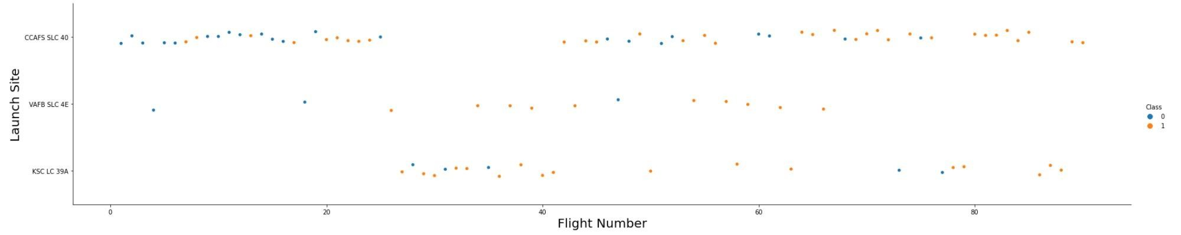
Flight Number vs. Launch Site
Explanation:
The earliest flights all failed while the latest flights all succeeded.
The CCAFS SLC 40 launch site has about a half of all launches.
VAFB SLC 4E and KSC LC 39A have higher success rates.
It can be assumed that each new launch has a higher rate of success.

Slide 19
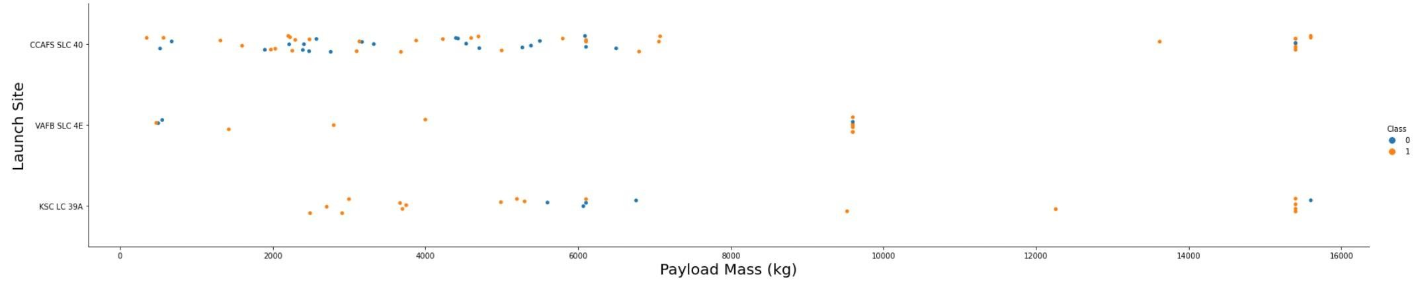
Payload vs. Launch Site
Explanation:
For every launch site the higher the payload mass, the higher the success
rate.
Most of the launches with payload mass over 7000 kg were successful.
KSC LC 39A has a 100% success rate for payload mass under 5500 kg too.

Slide 20
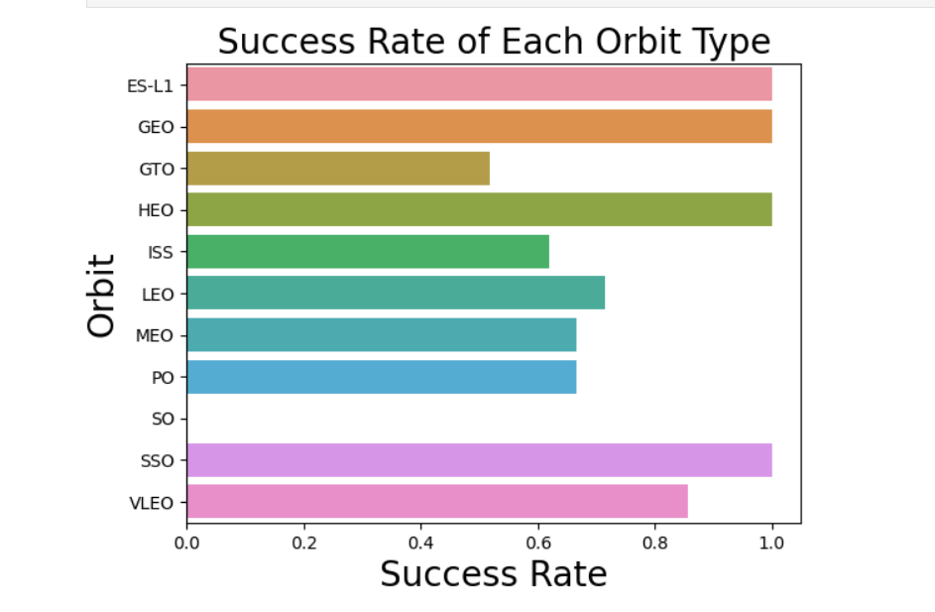
Success Rate vs. Orbit Type
EXPLANATION:
Orbits with 100% success rate:
ES-L1, GEO, HEO, SSO
Orbits with 0% success rate:
SO
Orbits with success rate between 50% and 85%:
GTO, ISS, LEO, MEO, PO

Slide 21
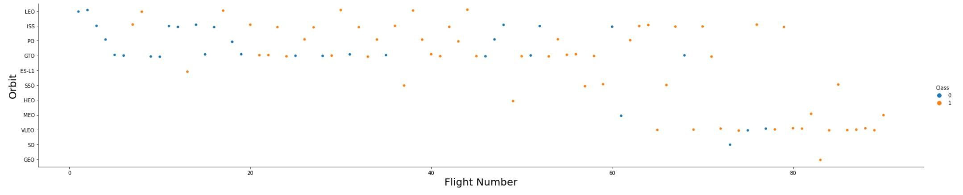
Flight Number vs. Orbit Type
Explanation:
In the LEO orbit the Success appears related to the number of flights; on the other hand, there seems to be no relationship between flight number when in GTO orbit.

Slide 22
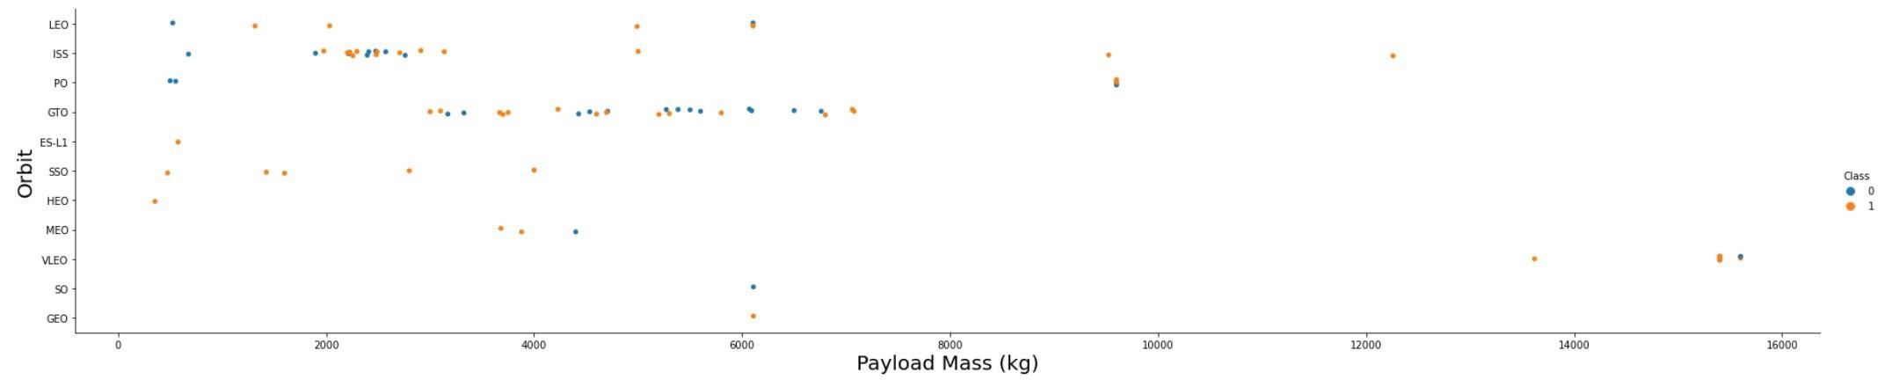
Payload vs. Orbit Type
Explanation:
Heavy payloads have a negative influence on GTO orbits and positive on GTO and Polar LEO (ISS) orbits.

Slide 23
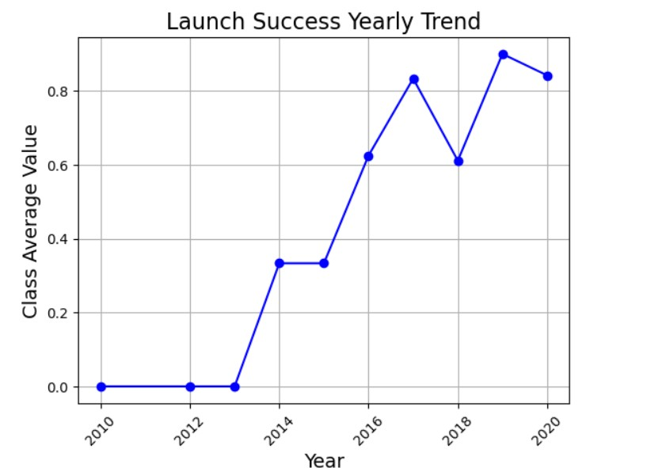
Launch Success Yearly Trend
EXPLANATION:
The success rate since 2013 kept increasing till 2020.

Slide 24
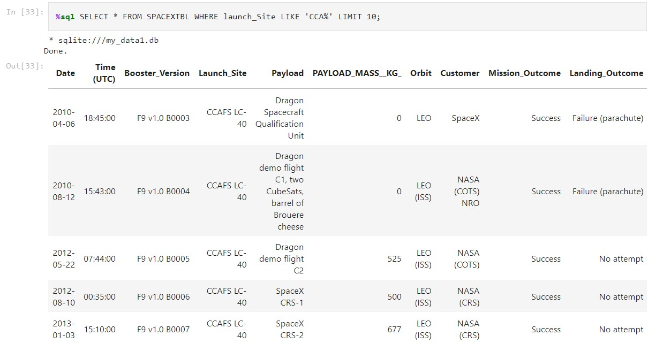
All Launch Site Names
Explanation:
Displaying the names of the unique launch sites in the space mission.

Slide 25
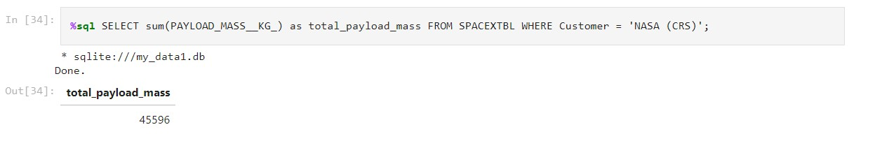
Launch Site Names Begin with 'CCA'
Explanation:
Displaying 5 records where launch sites begin with the string 'CCA'.

Slide 26
Total Payload Mass
Explanation:
Displaying the total payload mass carried by boosters
launched by NASA (CRS).

Slide 27
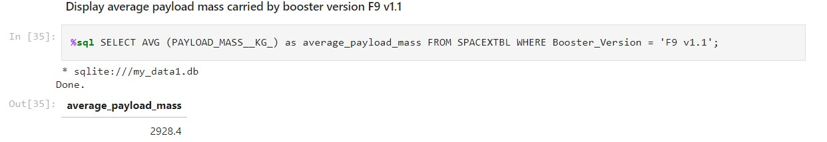
Average Payload Mass by F9 v1.1
Explanation:
Displaying average payload mass carried by booster version F9 v1.1.

Slide 28
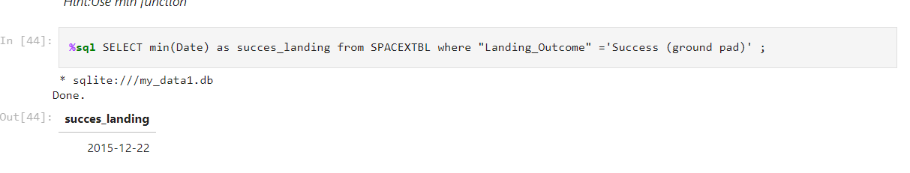
First Successful Ground Landing Date
Explanation:
Listing the date when the first successful landing
outcome in ground pad was achieved.

Slide 29
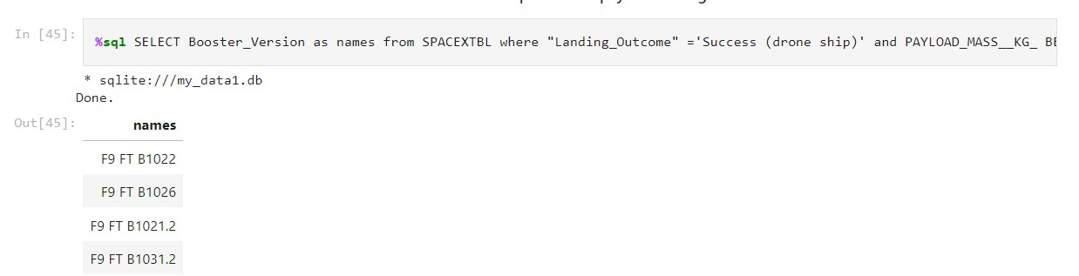
Successful Drone Ship Landing with Payload between 4000 and 6000
Explanation:
Listing the names of the boosters which have success in drone ship and have payload mass greater than 4000 but less than 6000.

Slide 30
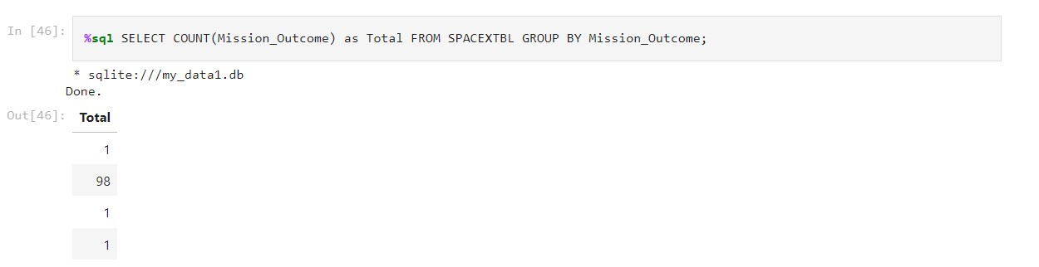
Total Number of Successful and Failure Mission Outcomes
Explanation:
Listing the total number of successful and failure mission outcomes.

Slide 31
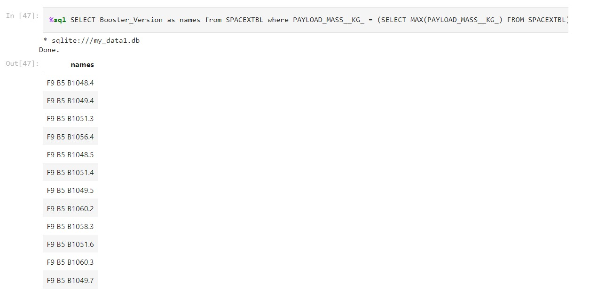
Boosters Carried Maximum Payload
Explanation:
Listing the names of the booster versions which have
carried the maximum payload mass.

Slide 32
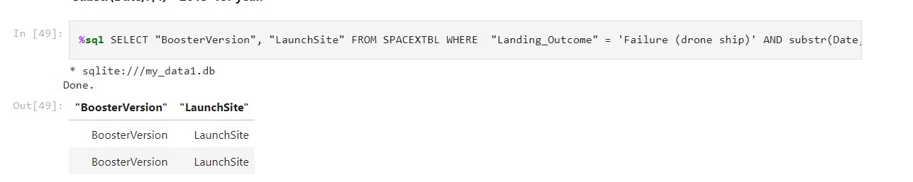
2015 Launch Records
Explanation:
Listing the failed landing outcomes in drone ship, their booster versions and launch site names for the months in year 2015

Slide 33
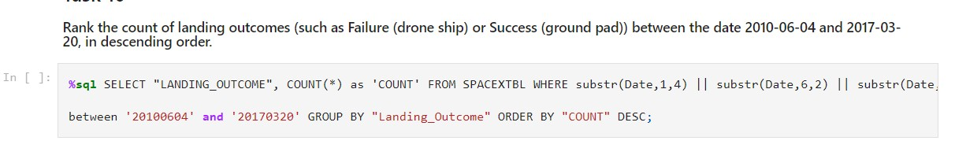
Rank Landing Outcomes Between 2010-06-04 and 2017-03-20
Explanation:
Ranking the count of landing outcomes (such as Failure (drone ship) or Success (ground pad)) between the date 2010-06-04 and 2017-03-20 in descending order.

Slide 34

Section 3

Slide 35
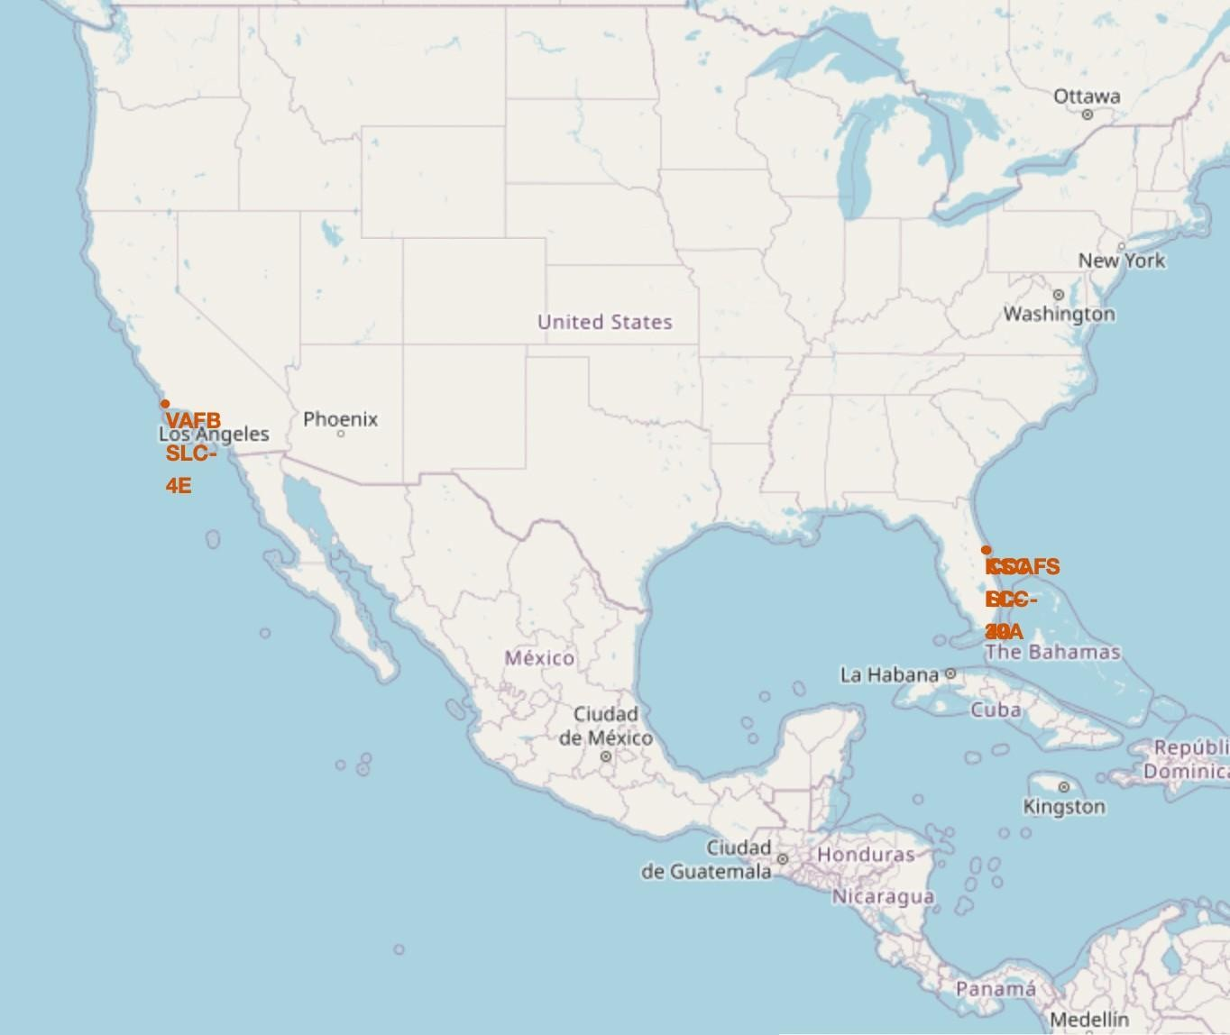
<Folium Map Screenshot 1>
Explanation:
Most of Launch sites are in proximity to the Equator line. The land is moving faster at
the equator than any other place on the surface o f the Earth. Anything on the surface o f the Earth at the equator is already moving at 1670 km/ hour. If a ship is launched f rom the equator it goes up
into space, and it is also moving around the Earth at the same speed it was
moving before launching. This is because
of inertia. This speed will help the
spacecraft keep up a g o od enough speed to stay in orbit.
All launch sites are in very close
proximity t o the coast, while launching rockets towards the ocean it minimises the risk o f having any debris dropping or exploding near people.

Slide 36
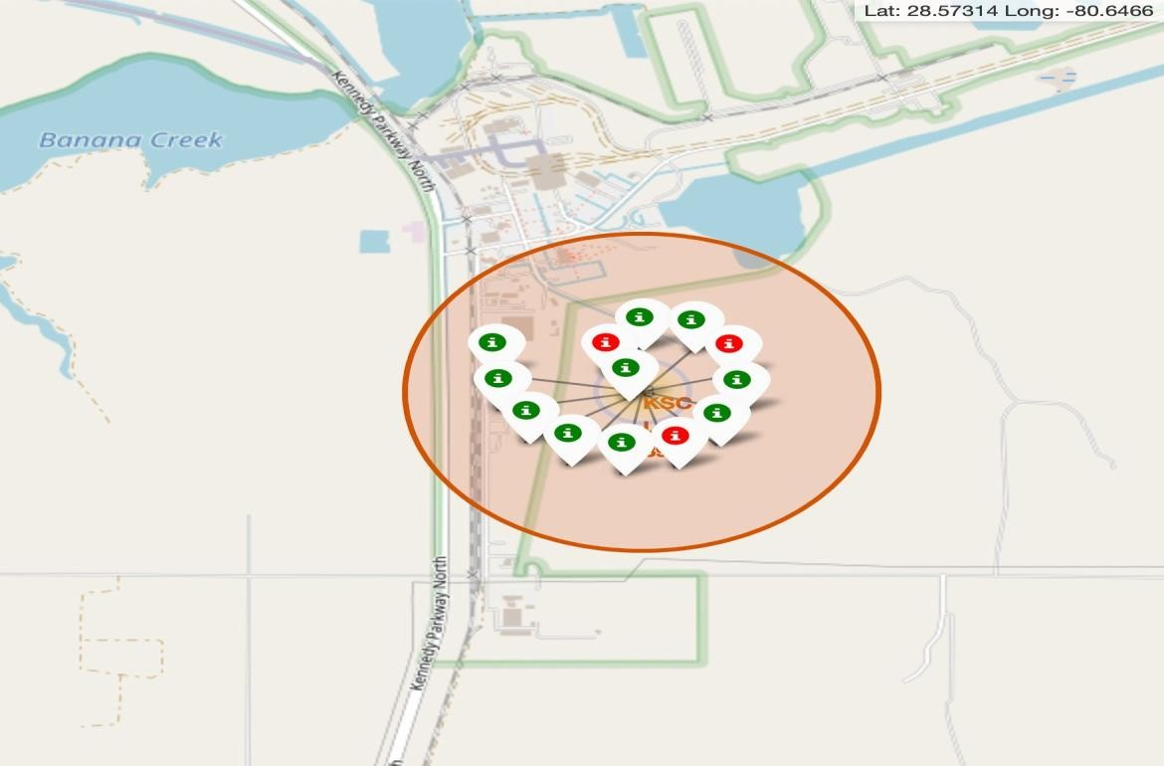
<Folium Map Screenshot 2>
Explanation:
From t h e colour- labeled markers we should be able t o easily i d e n t i f y w h i c h launch sites have
relatively h i g h success rates.
Green Marker =Su c c e ssful Launch
Red Marker =Failed Launch
Launch Site KSC LC-39A has a very h i g h
Success Rate.
•

Slide 37
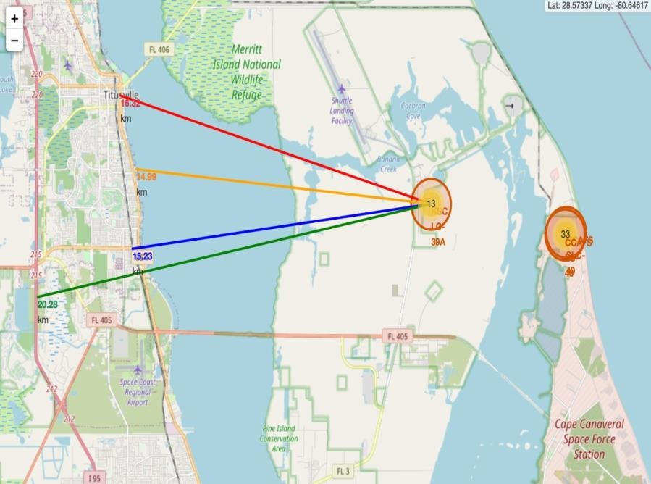
<Folium Map Screenshot 3>
Explanation:
From the visual analysis of the launch site KSC LC-39A we can clearly see that it is:
relative close to railway (15.23 km)
relative close to highway (20.28 km)
relative close to coastline (14.99 km)
Also the launch site KSC LC-39A is relative close to its closest city Titusville (16.32 km).
Failed rocket with its high speed can cover distances like 15-20 km in few seconds. It could be potentially dangerous to populated areas.

Slide 38

Section 4

Slide 39
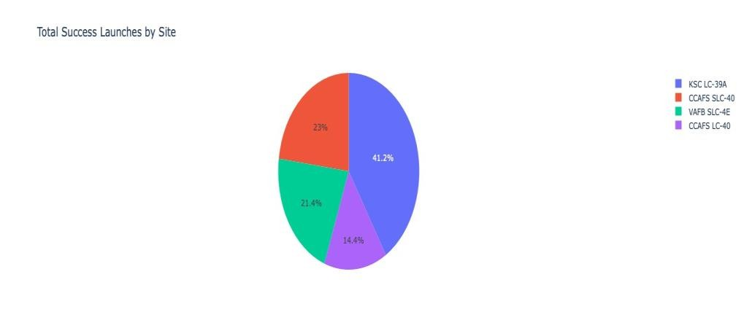
LAUNCHES SUCCES COUNT
Explanation:
The chart clearly shows that from all the sites, KSC LC- 39A has the most successful launches.

Slide 40
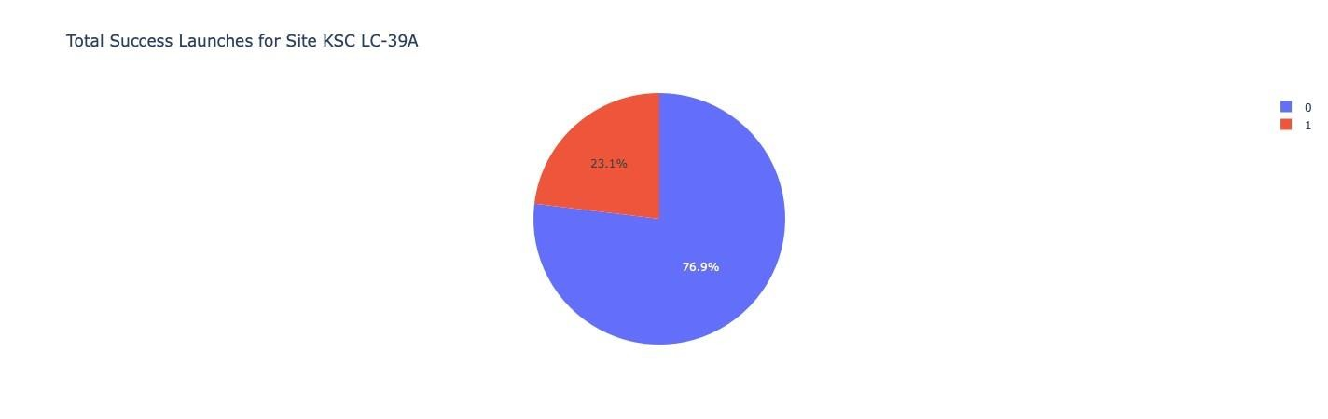
SITES WITH HIGHEST LAUNH SITE RATIO
Explanation:
KSC LC-39A has the highest launch success rate (76.9%) with 10 successful and only 3 failed landings.

Slide 41
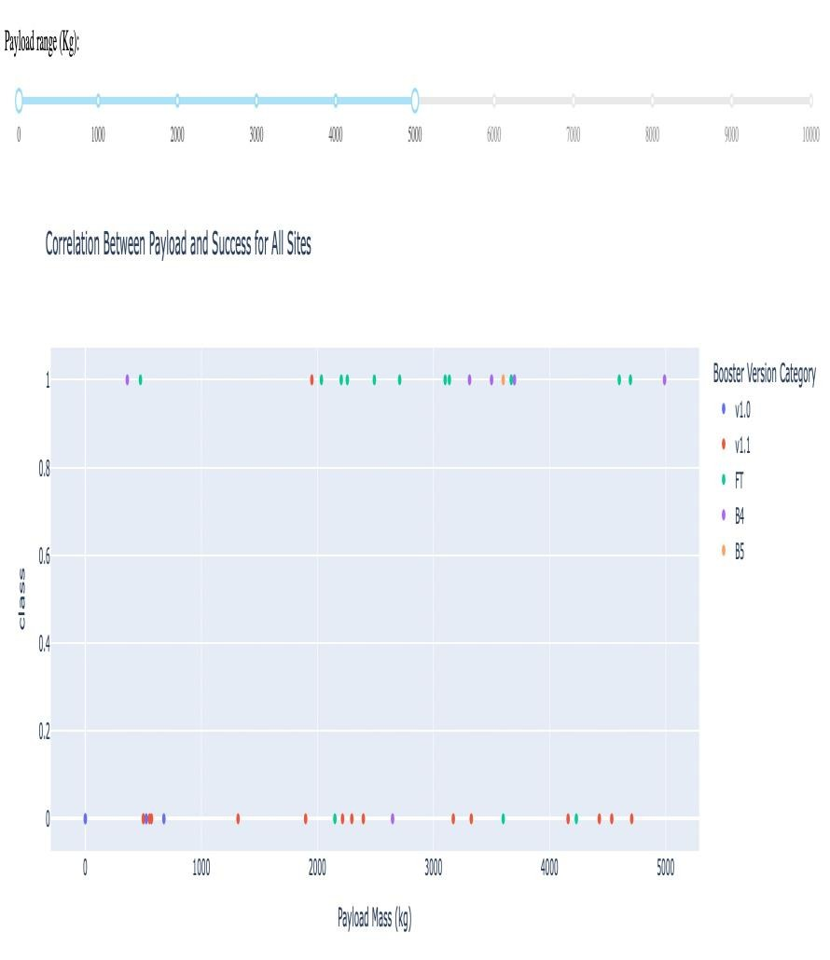
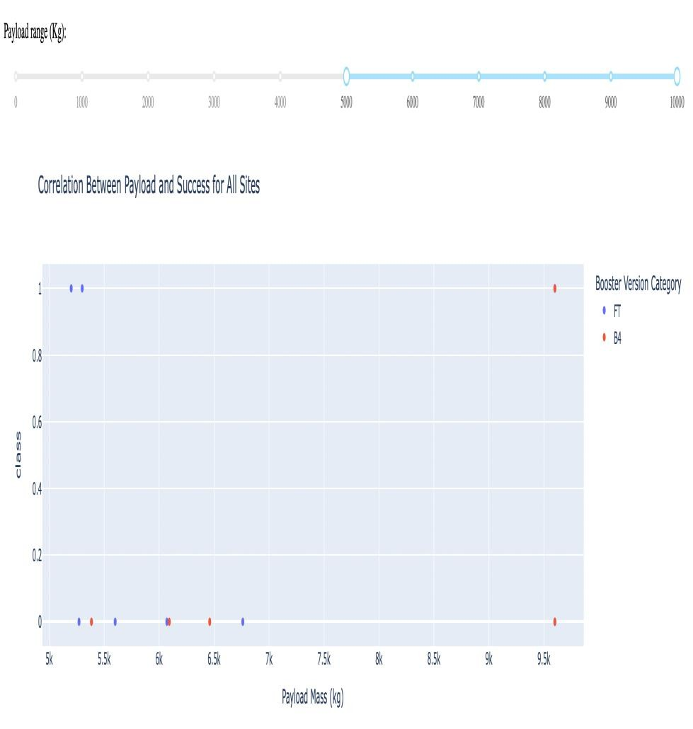
PAYLOAD VS LAUCH OUTCOME SITES
Explan at i o n :
The charts show that payloads between 2000 and 5500 kg have the highest success rate.

Slide 42

Section 5

Slide 43
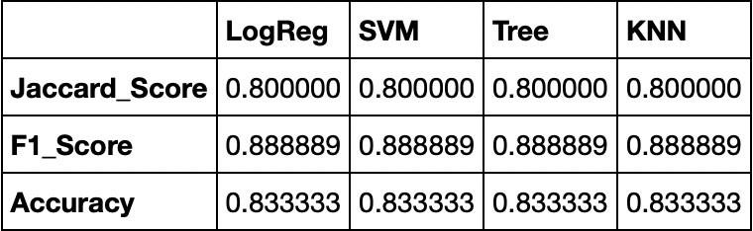
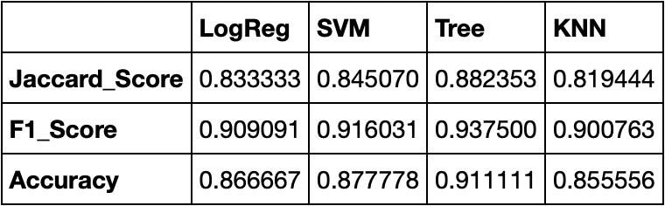
Classification Accuracy
Explanation:
Based on the scores of the Test Set, we can n o t confirm w h i c h m e t h o d performs best.
Same Test Set scores may be due t o the small test sample size (18 samples). Therefore, we tested all methods based on the whole Dataset.
The scores o f the whole Dataset confirm that the best m o d e l is the Decision Tree Model. This m o d e l has not only higher scores, but also the highest accuracy.
Scores a n d A c c u r a c y o f t h e Test Set
Scores and A c c u r a c y of t h e Entire Data Set

Slide 44
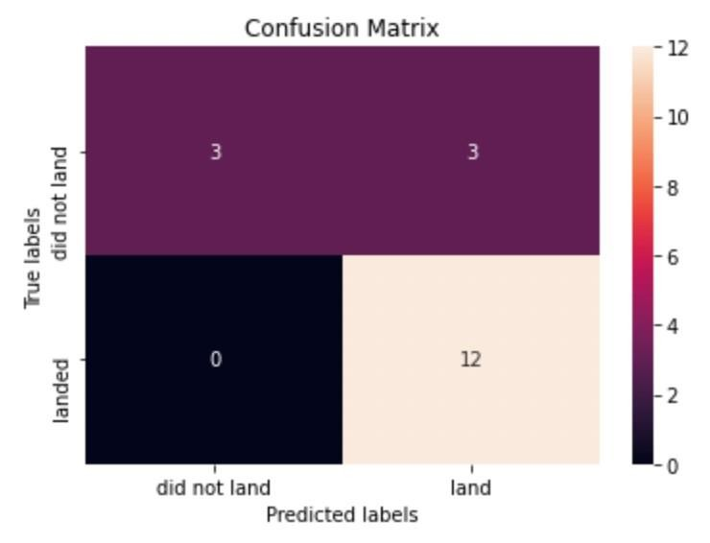
Confusion Matrix
EXPLANATION
Examining the confusion matrix, we see that logistic regression can distinguish between the different classes. We see that the major problem is false positives.

Slide 45
Conclusions
The optimal algorithm for this dataset is the Decision Tree Model. Launches characterized by lower payload mass exhibit superior outcomes compared to those with a higher payload mass. The majority of launch sites are located in close vicinity to the Equator, and all sites are situated in immediate proximity to coastlines. Over the passage of time, there is an observable upward trend in the success rate of launches. Among all launch sites, KSC LC-39A boasts the highest success rate. The orbits denoted as ES-L1, GEO, HEO, and SSO consistently demonstrate a perfect success rate of 100%.

Slide 46
Appendix
Include any relevant assets like Python code snippets, SQL queries, charts,
Notebook outputs, or data sets that you may have created during this project

Slide 47


